Slide 1
IBM University Engagement Project Submission
“Exploring the Power of Agentic AI with IBM Granite and LangFlow”

Slide 2

Project Title: AI-Powered Trek Planner
Domain: Tourism & Travel
Student Name | Recent Passport Photo | Email ID | Mobile number [WhatsApp]
Tanvi Patil |  | tavippatil2217@gmail.com | 7498819853

Slide 3
Problem Statement -
Planning a trekking trip can be challenging because information about trekking destinations, routes, weather, difficulty levels, permits, accommodation, and safety precautions is scattered across multiple websites. Beginners often struggle to choose suitable treks according to their fitness level and available time.
The Challenge
Lack of centralized information results in poor planning, increased travel costs, and safety risks.
The Objective
The objective of this project is to develop an AI-powered Trek Planner that provides personalized trekking recommendations, destination details, weather information, itinerary generation, and travel guidance through an intelligent chatbot interface.

Slide 4
Proposed Solution -
The AI Trek Planner is a web-based application that helps users plan trekking trips efficiently.
The system allows users to:
Search trekking destinations
View trek details
Generate personalized trekking plans
Get AI-powered recommendations
Receive weather and travel suggestions
Access safety guidelines
Plan itineraries according to duration and difficulty
The application provides all essential trekking information in one place,reducing planning effort and improving user experience.

Slide 5
Technology Used
Replace with your actual technologies.
Example:
Python
Flask
HTML
CSS
JavaScript
IBM Granite Model
LangFlow
IBM Watsonx.ai
GitHub
REST APIs
SQLite

Slide 6
Langflow component Used -
Example:
1. Chat Input
Accepts user trekking queries.
2.IBM Watsonx AI Agent
Processes user questions using Granite model.
3.Granite 4.0 8B Instruct
Generates intelligent trekking recommendations.
4.Chat Output
Displays personalized trekking plans.
5.Prompt Template
Creates structured prompts for the AI.
6.API Component
Fetches trekking information and weather data.

Slide 7

Role of Agentic AI in the solution
Role of Agentic AI
Agentic AI enables the Trek Planner to act as an intelligent travel assistant rather than a simple chatbot.
It understands user preferences such as:
Trek difficulty
Budget
Duration
Location
Season
The AI analyzes user input, retrieves relevant trekking information, generates personalized itineraries, and recommends suitable trekking destinations.
It continuously adapts recommendations based on user queries, making the planning process smarter and more interactive.

Slide 8
Novelty and Uniqueness
AI-powered personalized trek planning
Smart destination recommendation
Interactive chatbot
Weather-aware suggestions
Beginner-friendly trekking guidance
Fast itinerary generation
Uses IBM Granite Large Language Model
Built using LangFlow visual workflow
Easy-to-use web interface

Slide 9
Git Hub Link
·Repository:
https://github.com/tanvi523/trek-plan.git
·
·
·

Slide 10
Future Scope
Live weather integration
Google Maps navigation
Hotel booking integration
Trek permit booking
Offline itinerary download
Emergency SOS feature
Budget estimation
AI image recognition of trekking routes
Mobile application
Voice assistant support
·
·
·

Slide 11


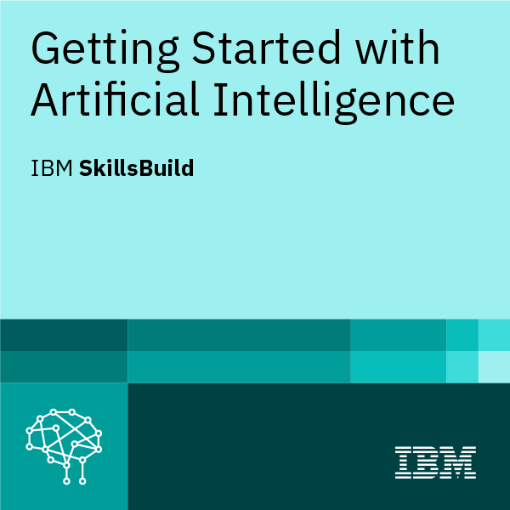

Certificates Earned:

Slide 12
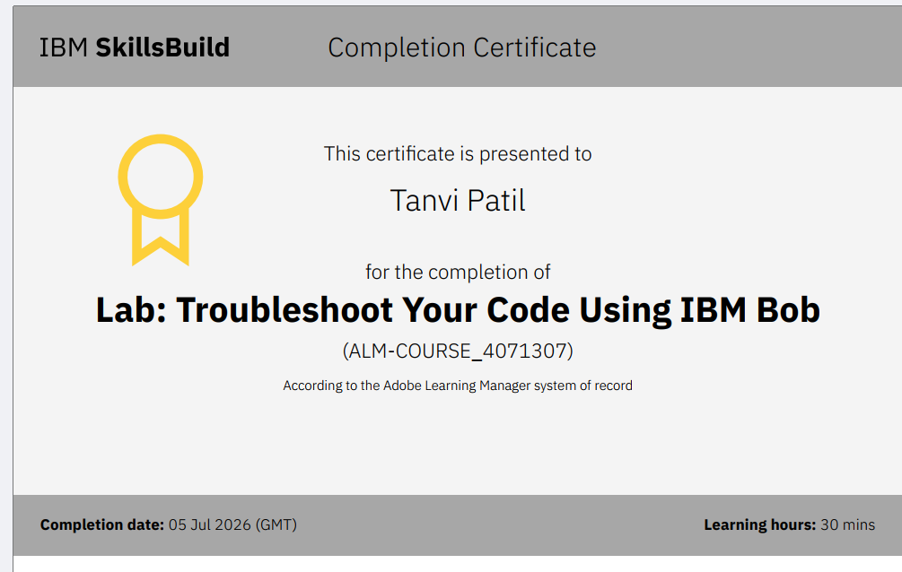
Certificates Earned:​

